Slide 2
A Causal Analysis of Corner Kicks
By – Harsh Mishra

Slide 3
Corner Kicks in Football

Slide 4
How is this work useful?
A solution that minimizes human intervention & saves time.
Analyzes various features impacting corner kicks (confounders).
Identifies root causes of how shots are created during corners.
Finds the best match-ups:
Best Attacking setup against different Defensive setups.
Best Attacking setup for different Corner types.
**Routine Inspection: A Playbook for Corner Kicks – Laurie Shaw (2020) [1]

Slide 5
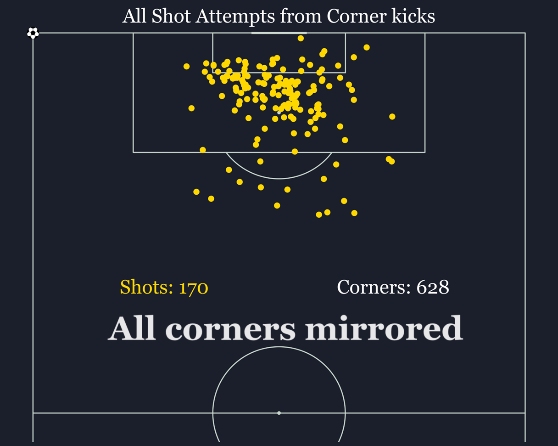
Data (Corners played into the box)

Slide 6
Proposed Solution

Slide 7
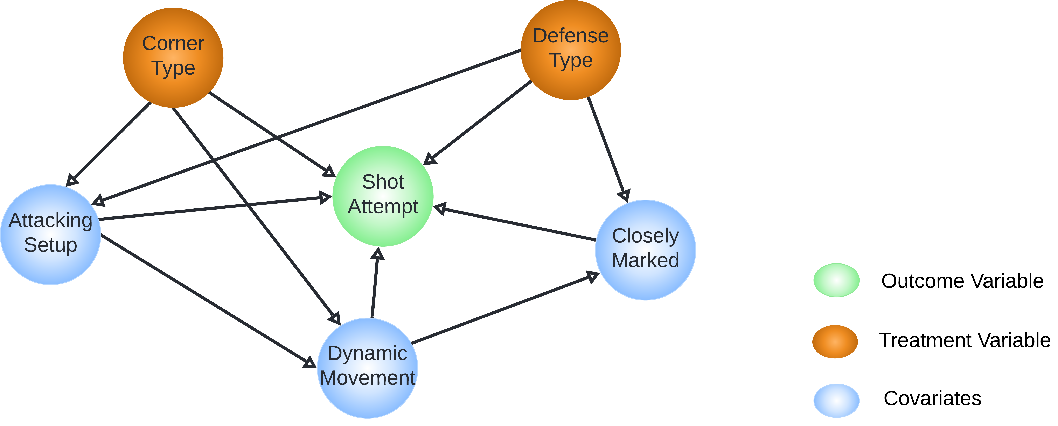
Proposed Solution
Graphical Causal Model

Slide 8
Features
Shot Attempt (Recorded)
0 – No shot
1 – Goals / Attempt Saved / Miss
Corner Type (Recorded)
0 – Inswinger
1 – Outswinger
Defense Type (Extracted)
0 – Man Mark
1 – Zonal
GMM Clustering using-:
Distance between attacker & closest marker - Linear Sum Assignment problem
Number of attackers within 6 yards of goal
Number of defenders within 6 yards of goal

Slide 9
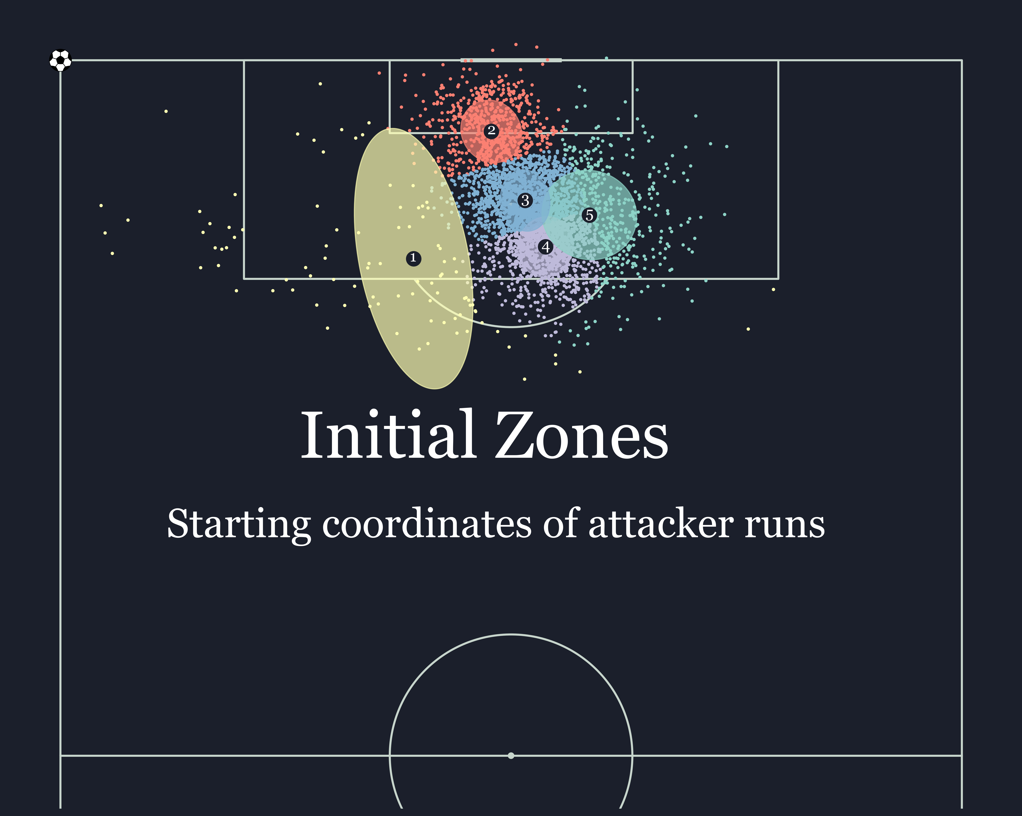
Features
Attacking Setup (Extracted)
Inherit the method proposed by [1]

Slide 10
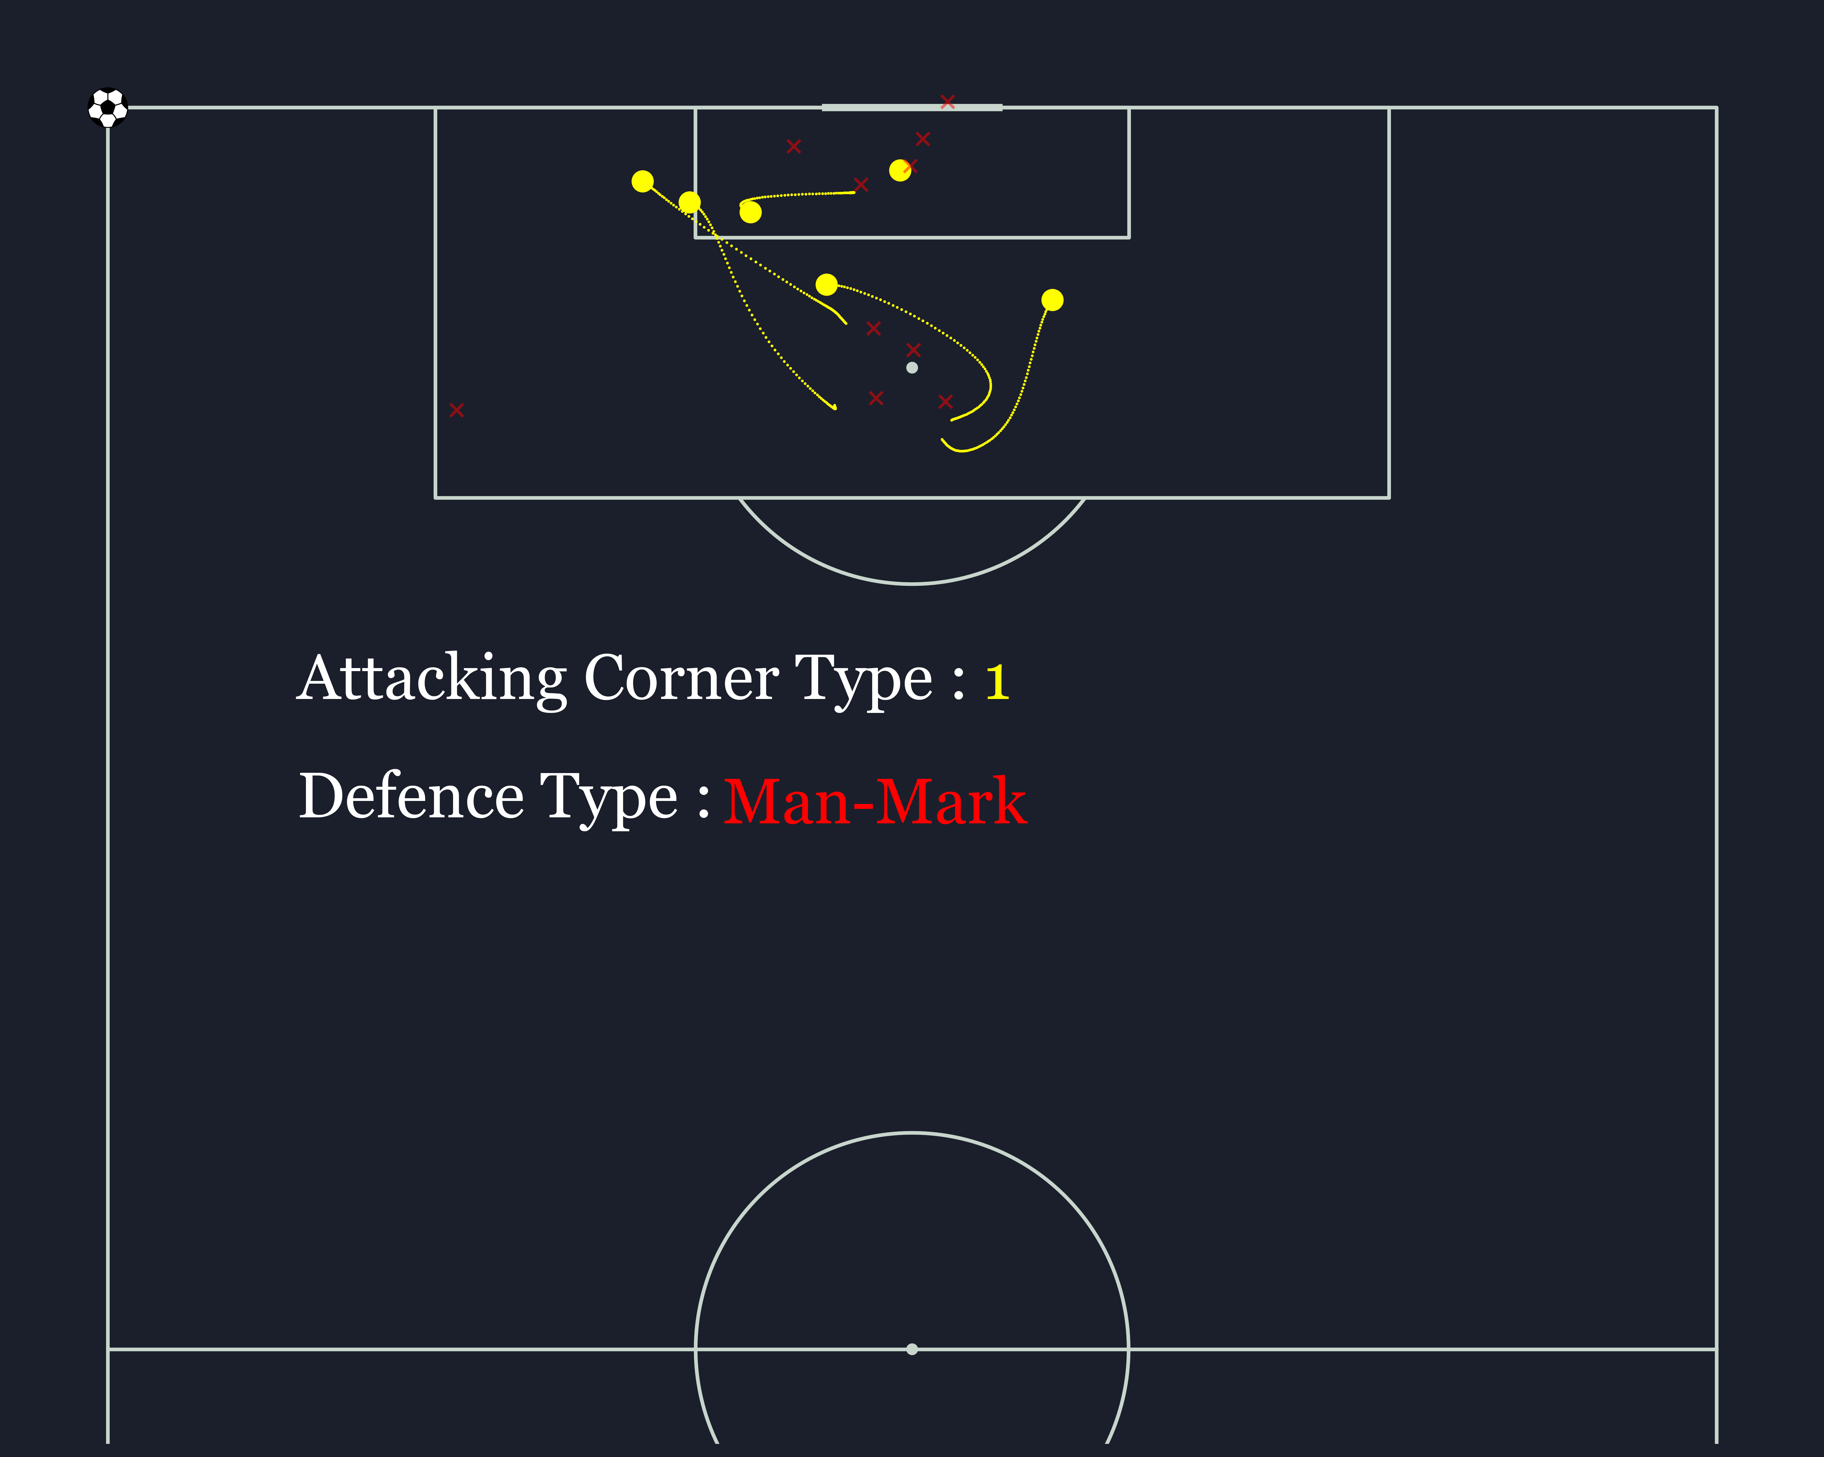
Attacking Setup: Cluster 1
Start from near post – 171 samples

Slide 11
Attacking Setup: Cluster 2
Runs from deeper areas to the back post – 123 samples

Slide 12
Attacking Setup: Cluster 3
Two-way movement – 224 samples

Slide 13
Attacking Setup: Cluster 4
Near post runs – 110 samples

Slide 14
Features
Closely Marked (Extracted)
0 – No
1 – Yes
Threshold – 1.45m (Median distance between attacker & closest defender)
Yes, if distance of more than half the attackers was found to be less than the median distance.
Dynamic Movement (Extracted)
0 – No
1 – Yes
Period – The frames when the ball travels from the corner spot till the edge of the penalty box
Yes, if more than half of the attackers have speed more than average speed.

Slide 15
Exploratory Analysis

Slide 16
Exploratory Analysis
11 Goals scored out of 628 corner situations (1.75%)
Distribution of treatment features -:
170 Shot attempts out of 628 corners (27%)
35% off Out-swinging corners vs 18% off In-swinging corners
28% off Zonal corners vs 26% off Man-Marked corners

Slide 17
Exploratory Analysis
Dynamic Movement:
Closely Marked:

Slide 18
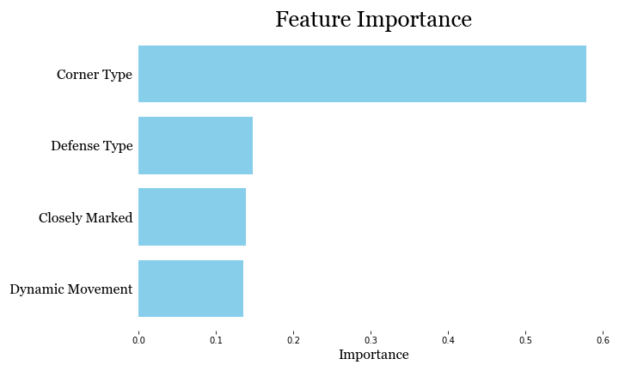
Exploratory Analysis
Traditional modelling
Training a Random Forest Classifier to predict Shot Attempts
82% accuracy – for this dataset
Corner Type – the most predictive feature – for this dataset

Slide 19
Causal Analysis

Slide 20
Causal Analysis
Non-parametric approach -:
e.g., Effect of Corner Type on Shot Attempt :
$\frac{d}{d[Corner Type]}$ $\left(E\left[Shot Attempt | Attacking Setup, Dynamic Movement, Defense Type\right]\right)$
Average Treatment Effect -:
$\frac{1}{N}\sum_{i}^{ }{\left(y_{1}\left(i\right) − y_{0}\left(i\right)\right)}$
Corner Type : 0.14
Defense Type : 0.02
Dynamic Movement : - 0.08
Closely Marked : 0

Slide 21
Causal Analysis
Parametric approach -:
Each node has its own parametric model
Treatment Variables: Empirically Distributed
Covariates: Random Forest Classifier
Intervention -:
Outcome (Y) - Shot Attempt $∈$ [0,1]
Treatment (T) $∈$ [0,1]
Mediator (M) - Attacking Setup $∈$[0,1]
$\left[Y | do \left(T=t, M =m\right)\right]$

Slide 22
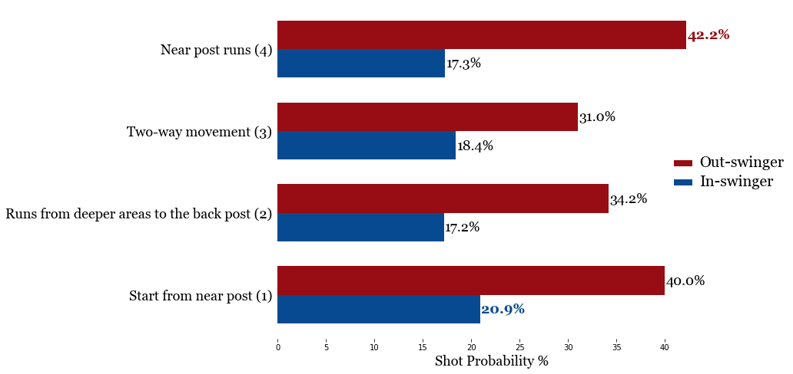
Causal Analysis
Attack Setup vs Corner Type

Slide 23
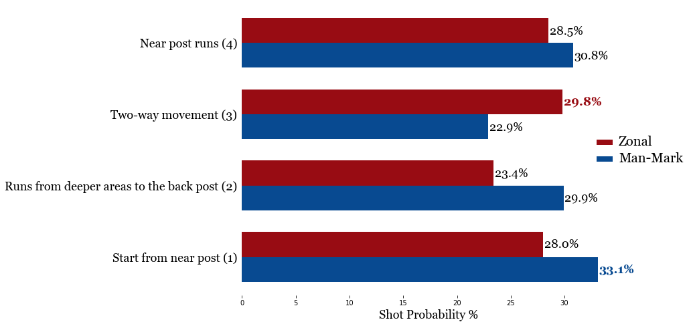
Causal Analysis
Attack Setup vs Defense Type

Slide 24
Conclusion

Slide 25
Conclusion
Advantages of the approach -:
Findings are Actionable & Explainable
Saves time – Minimal human intervention
Brings various features based on tracking data into context
Customizable approach – Adds domain expert knowledge
Best Shot Producing Matchups -:
Out-swinging corners - Near post runs
In-swinging corners - Attackers starting at near post
vs Zonal defense - Two-way movement
vs Man-Marking defense - Attackers starting at near post

Slide 26
Thank You!

